Slide 1
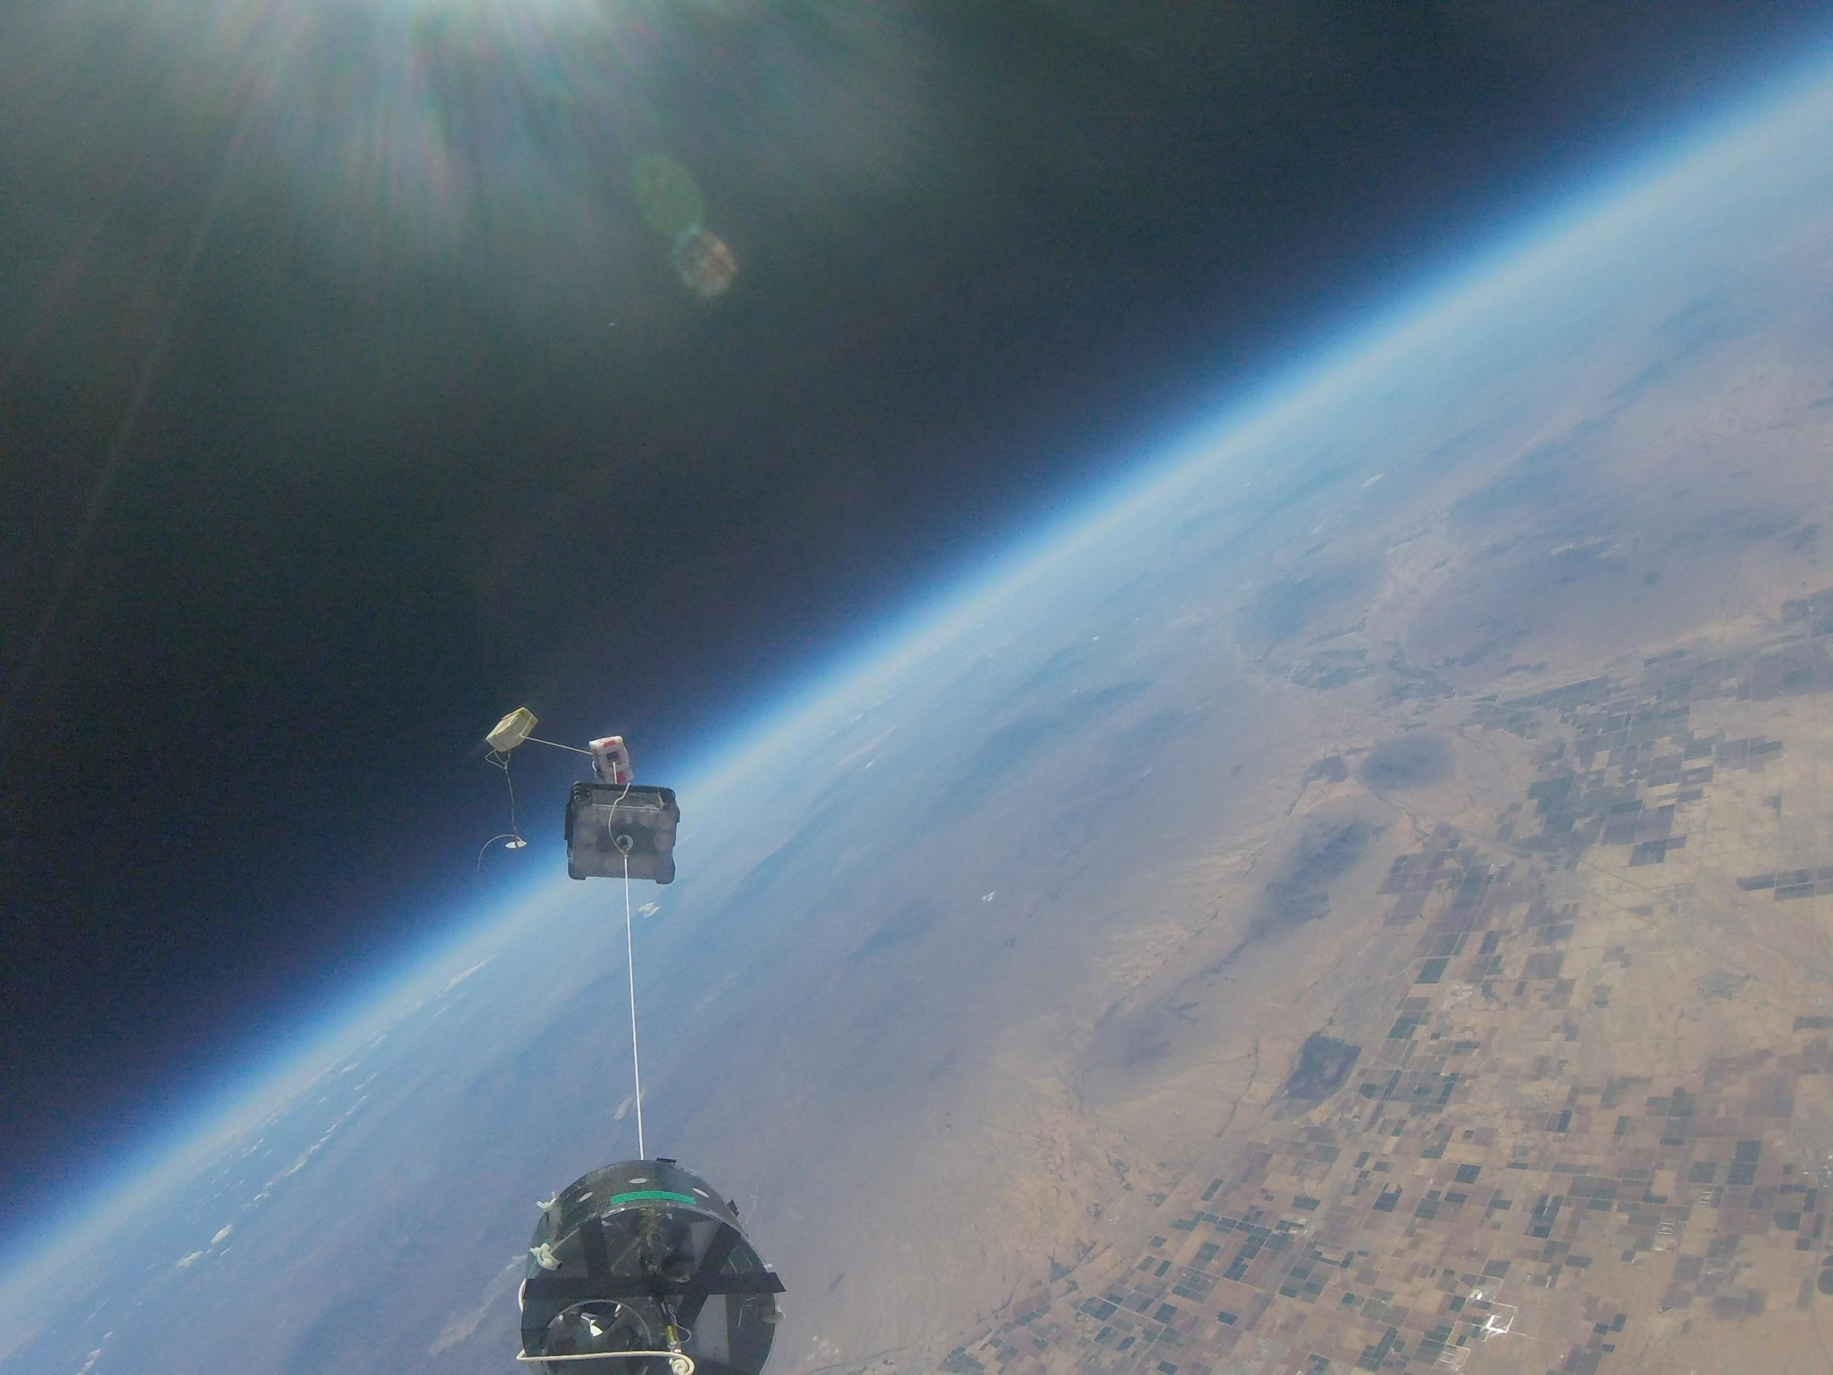
URSA MAJOR
ASCEND TEAM 2016!

Slide 2
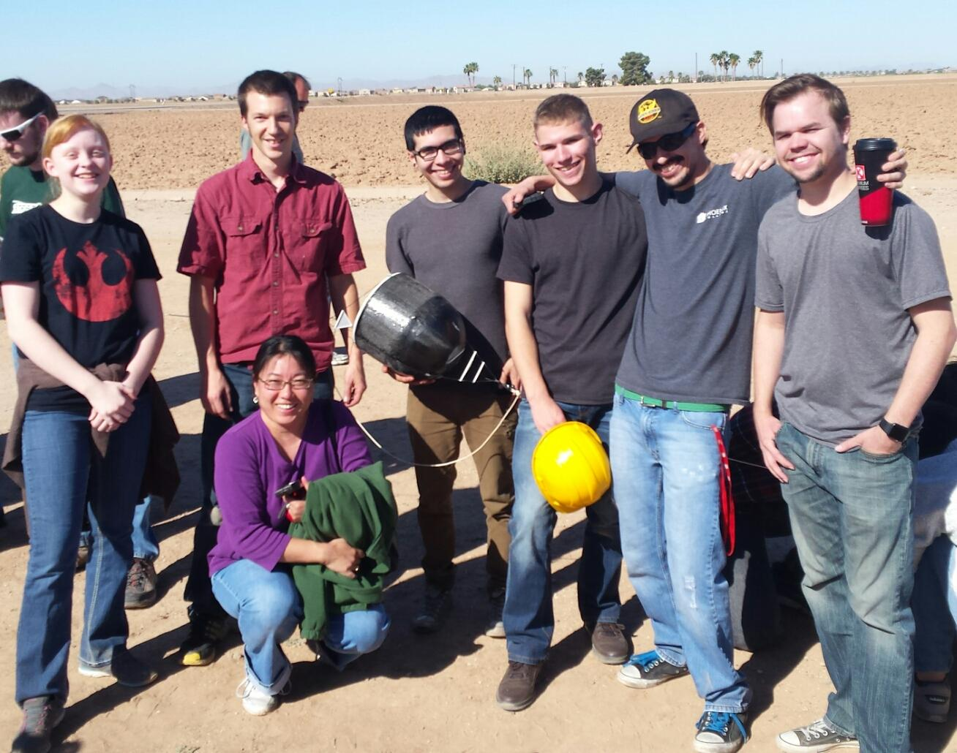
OUR TEAM
Paul Ronquillo
Jonathan Cahal
Eli Sonafrank
Jake Denison
Oliver Salmeron
Cordelia Torrey
Ainsley Chapman

Slide 3
ACKNOWLEDGEMENTS
Mentor: Ernest Villicaña
Dr. Ed Ong
Dr. Tim Frank

Slide 4
OUTLINE
GOALS/OBJECTIVES
DESIGN
Housing
Electronics & Sensors
Software
RESULTS
CONCLUSION & FUTURE STUDIES

Slide 5
GOALS
FALL 2015
Dual redundant systems
Strong expandable technology base
SPRING 2016
Add wireless communication feature
Capture flight photos
Measure air composition

Slide 6
DESIGN
PAYLOAD HOUSING
ELECTRONIC CONTROLLERS
SENSORS
SOFTWARE

Slide 7
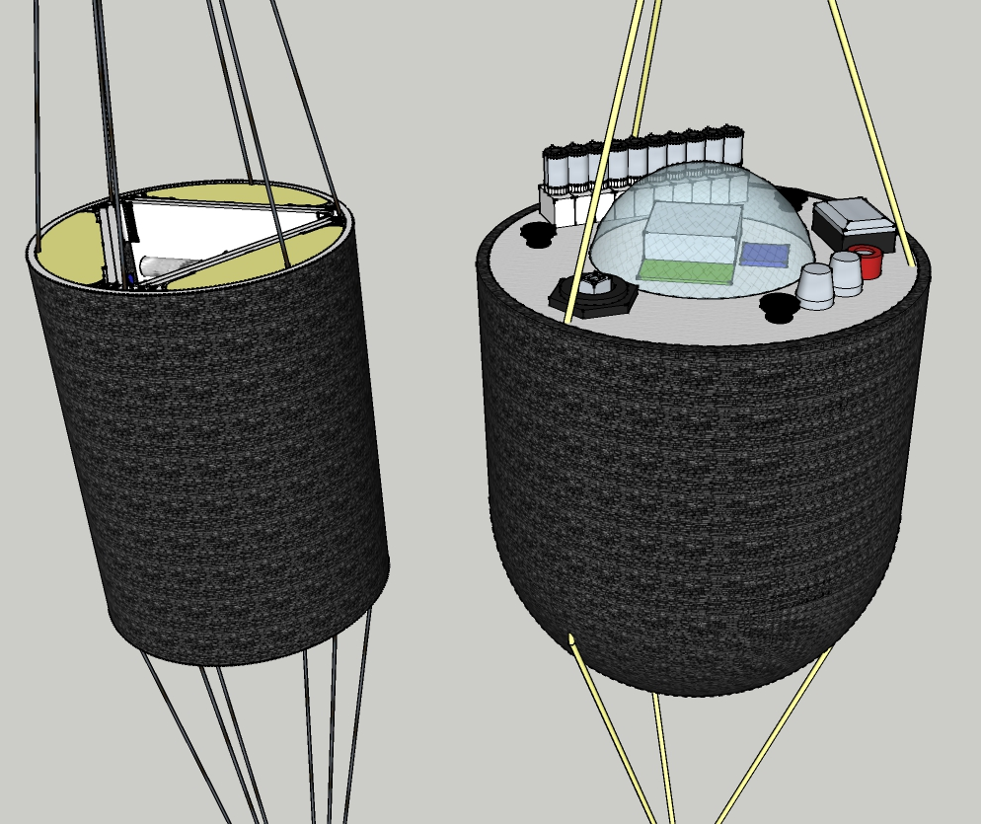
DESIGN:
PAYLOAD HOUSING
FALL 2015
SPRING 2016
Detail for housing in next presentation.

Slide 8
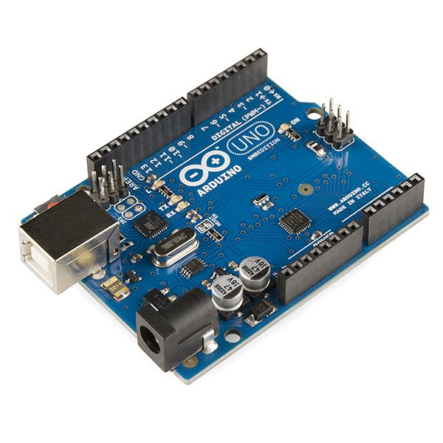
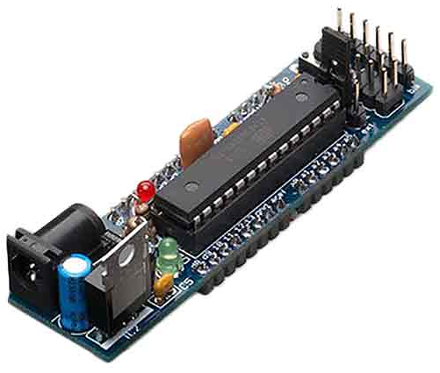
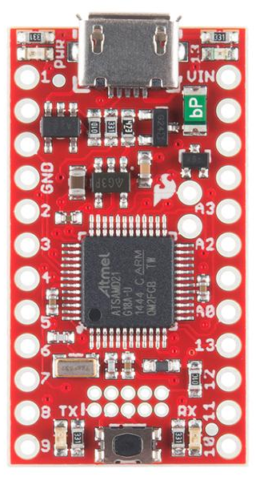
DESIGN:
ELECTRONICS
SPRING 2015
FALL 2015

Slide 9
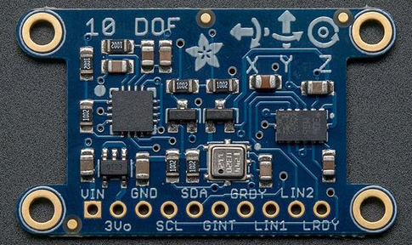
DESIGN: ELECTRONICS
Spr Sensing/Input
10 DOF IMU
Ultimate GPS
GoPro Hero 4 Session
MQ4 Methane
MQ6 LPG
MQ7 Carbon monoxide

Slide 10
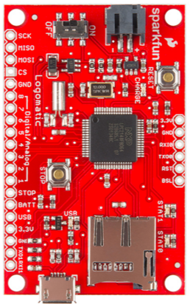
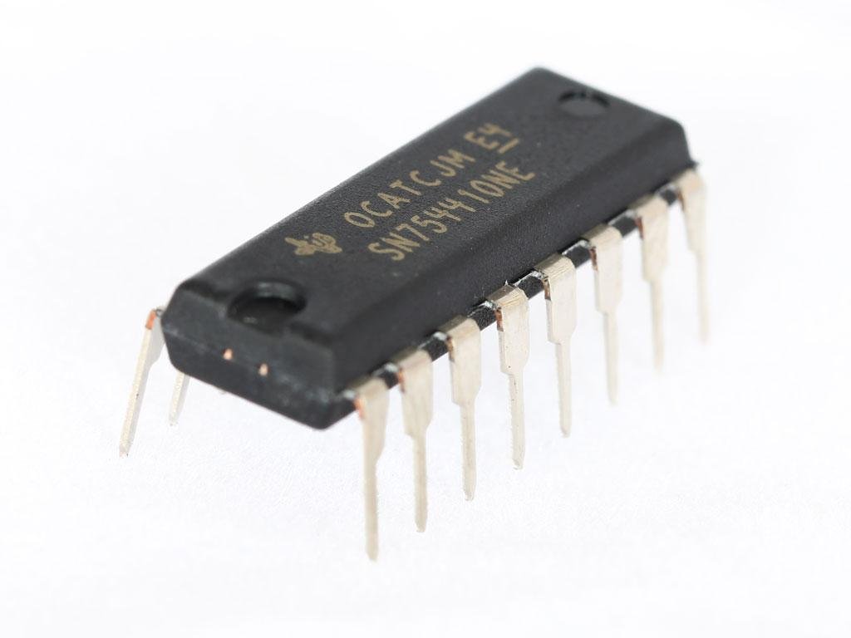
DESIGN: ELECTRONICS
Spr Logging/Actuation
Rockblock satellite transmitter
Sparkfun Logomatic
4 X SN754410 quad half-H bridge driver IC

Slide 11
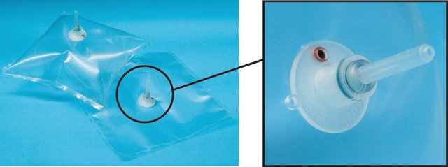
DESIGN: ELECTRONICS
Spr Gas Capture
Rockblock satellite transmitter
Sparkfun Logomatic
4 X SN754410 quad half-H bridge driver IC

Slide 12
DESIGN: SOFTWARE
Sensing/Logging
Wireless
Start
Start
Arduino Uno
Boarduino
GPS Fix?
Send startup
message
Motor Drive
Y
Start
Ave. Altitude
UART
Check Altitude
SAMD21
Y
Falling?
Motor selection
Transmit location
Request status
UART
RCV status
Request
Drive air pumps
Logomatic
INSERT FLOWCHART

Slide 13
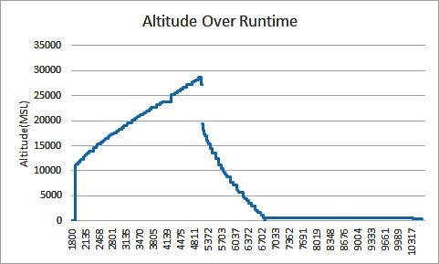
DESIGN
ELECTRONICS
RESULTS:
SPRING 2016
Sensors & Logging worked
In Flight Photography
worked
No air samples were captured
No Rockblock satellite link established

Slide 14
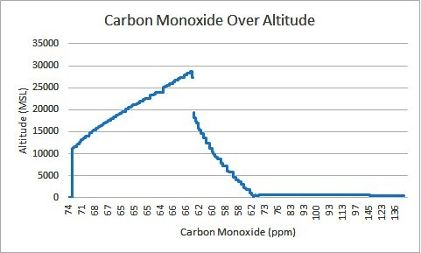
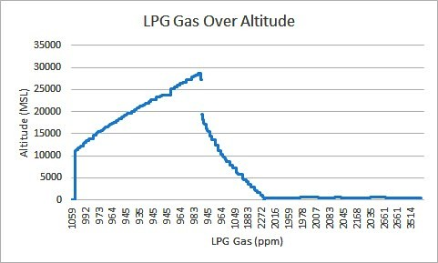
DESIGN
ELECTRONICS
RESULTS:
SPRING 2016

Slide 15
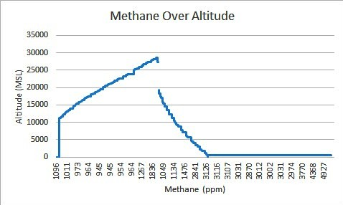
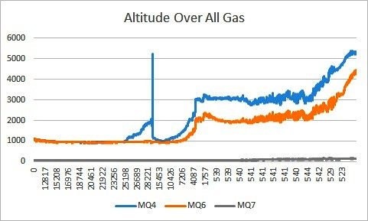
RESULTS:
SPRING 2016

Slide 16
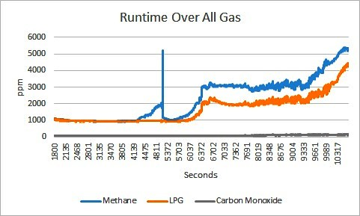
RESULTS:
SPRING 2016

Slide 17
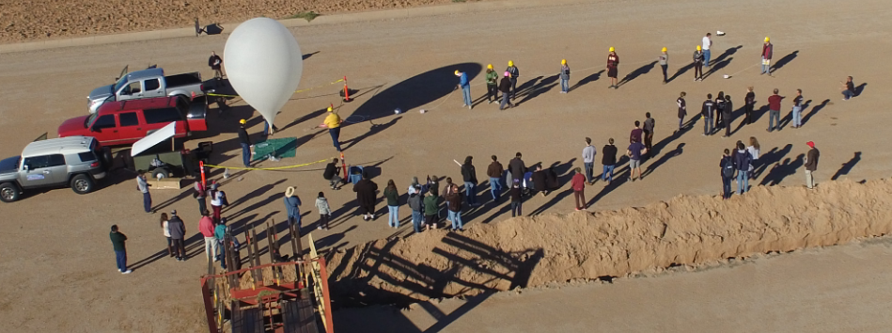
RESULTS:
HD In flight Photography

Slide 18
Notes:
video located here https://www.youtube.com/watch?v=V5MxW4sODtE

Slide 19
CONCLUSION
Created Versatile Payload Housing Design
Improved fabrication & implementation
Measurement with MQ series successful
Gas sample system failed
GPS data successfully recorded

Slide 20
THANK YOU!
URSA MAJOR
ASCEND TEAM 2016

